Slide 1
IDENTIFYING AND SELECTING SYSTEMS
DEVELOPMENT PROJECTS
Chapter 2

Slide 2
LEARNING OBJECTIVES
Describe the project identification and selection process.
Describe corporate strategic planning and information systems planning process.
Describe the three classes of Internet electronic commerce applications: business-to-consumer, business-to- employee, and business-to-business.

Slide 3
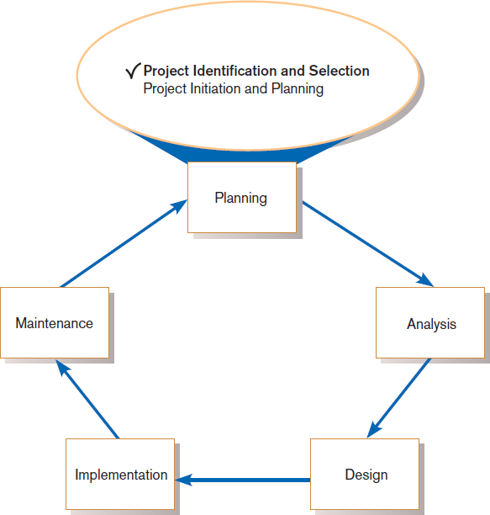
IDENTIFYING AND SELECTING SYSTEMS DEVELOPMENT PROJECTS
Systems development life cycle with project identification and selection highlighted
Three main steps:
Identifying potential development projects
Classifying and ranking IS development projects
Selecting IS development projects

Slide 4
THE PROCESS OF IDENTIFYING AND SELECTING IS DEVELOPMENT PROJECTS
1. Identifying potential development projects
✴ Identification from a stakeholder group
✴ Each stakeholder group brings their own perspective and motivation to the IS decision.

Slide 5
THE PROCESS OF IDENTIFYING AND SELECTING IS DEVELOPMENT PROJECTS (CONT.)
✴ Top-down source are projects identified by top management or by a diverse steering committee.
✴ Bottom-up source are project initiatives stemming from managers, business units, or the development group.
✴ The process varies substantially across organizations.

Slide 6
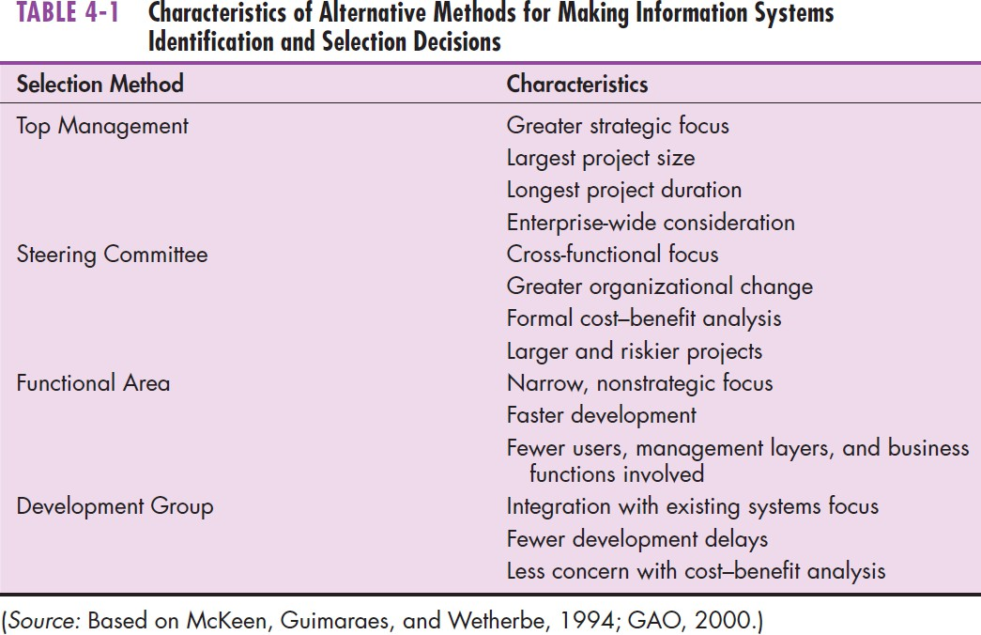
The Process of Identifying and Selecting IS Development Projects (Cont.)

Slide 7
THE PROCESS OF IDENTIFYING AND SELECTING IS DEVELOPMENT PROJECTS (CONT.)
2. Classifying and ranking IS development projects
✴ Using value chain analysis or other evaluation criteria
Value chain analysis: Analyzing an organization’s activities to determine where value is added to products and/or services and the costs incurred for doing so; usually also includes a comparison with the activities, added value, and costs of other organizations for the purpose of making improvements in the organization’s operations and performance

Slide 8
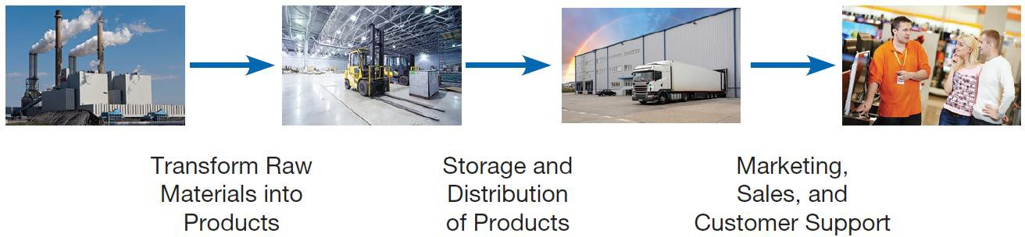
The Process of Identifying and Selecting IS Development Projects (Cont.)
Organizations can be thought of as a value chain, transforming raw materials into products for customers

Slide 9
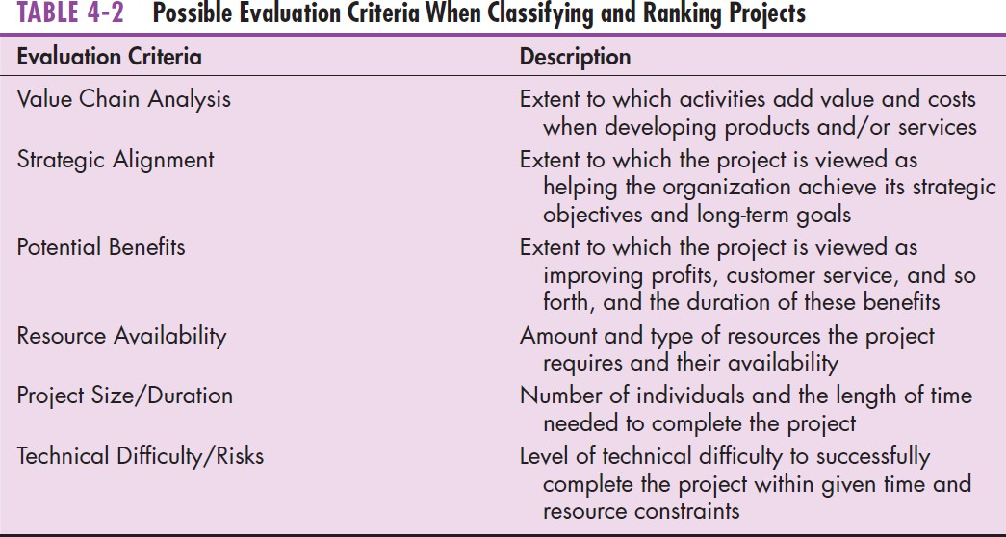
THE PROCESS OF IDENTIFYING AND SELECTING IS DEVELOPMENT PROJECTS (CONT.)

Slide 10
THE PROCESS OF IDENTIFYING AND SELECTING IS DEVELOPMENT PROJECTS (CONT.)
3. Selecting IS development projects
✴ Based on various factors
✴ Both short- and long-term projects considered
✴ Most likely to achieve business objectives selected
✴ A very important and ongoing activity

Slide 11
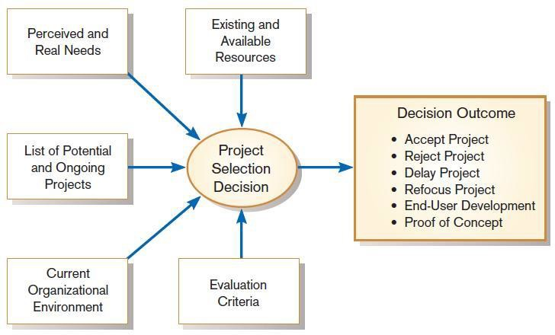
THE PROCESS OF IDENTIFYING AND SELECTING IS DEVELOPMENT PROJECTS (CONT.)
Project selection decisions must consider numerous factors and can have numerous outcomes

Slide 12
THE PROCESS OF IDENTIFYING AND SELECTING IS DEVELOPMENT PROJECTS (CONT.)
One method for deciding among different projects or alternative designs:
✴ For each requirement or constraint: Score = weight X rating
✴ Each alternative: sum scores across requirements/constraints
✴ Alternative with highest score wins

Slide 13
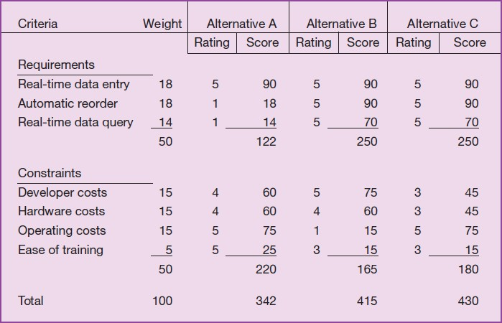
THE PROCESS OF IDENTIFYING AND SELECTING IS DEVELOPMENT PROJECTS (CONT.)
Alternative projects and system design decisions can be assisted using weighted multicriteria analysis

Slide 14
DELIVERABLES AND OUTCOMES
Primary deliverable from the first part of the planning phase is a schedule of specific IS development projects.
Outcome of the next part of the planning phase—project initiation and planning—is the assurance that careful consideration was given to project selection and each project can help the organization reach its goals.

Slide 15
DELIVERABLES AND OUTCOMES (CONT.)
Incremental commitment: a strategy in systems analysis and design in which the project is reviewed after each phase and continuation of the project is rejustified

Slide 16
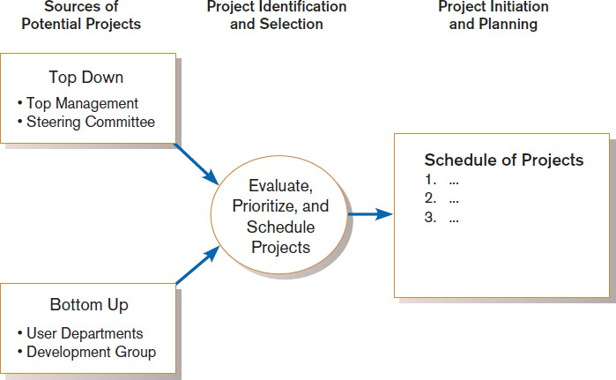
DELIVERABLES AND OUTCOMES (CONT.)
Information systems development projects come from both top-down and bottom-up initiatives.

Slide 17
CORPORATE AND INFORMATION SYSTEMS PLANNING
To benefit from a planning-based approach for identifying and selecting projects, an organization must:
✴ Analyze its information needs thoroughly.
✴ Plan its projects carefully.

Slide 18
REASONS FOR IMPORTANCE OF IMPROVED PLANNING
Increasing cost of information systems (40% of organizational expense)
Lack of cross-organizational applications and systems
Systems don’t address critical strategic problems
Too much data redundancy, lack of data quality High system maintenance costs
Long application backlogs

Slide 19
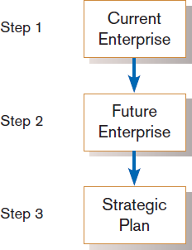
CORPORATE STRATEGIC PLANNING
Ongoing process that defines mission, objectives, and strategies of an organization
Corporate strategy involves:
✴ Mission statement
✴ Objective statements
✴ Description of competitive strategy
Corporate strategic planning is a three step Process.

Slide 20
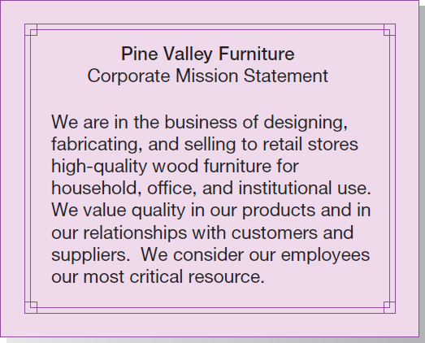
CORPORATE STRATEGIC PLANNING (CONT.)
Mission statement: a statement that makes it clear what business a company is in.
Mission statement (Pine Valley Furniture)

Slide 21
CORPORATE STRATEGIC PLANNING (CONT.)
Objective statement: a series of statements that express an organization’s qualitative and quantitative goals for reaching a desired future position.
Sometimes called “critical success factors”

Slide 22
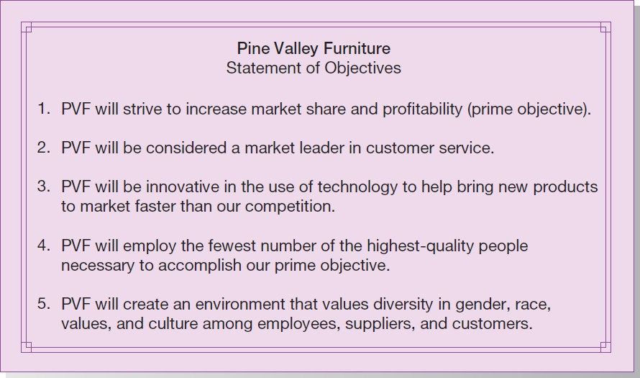
CORPORATE STRATEGIC PLANNING (CONT.)
Statement of Corporate Objectives (Pine Valley Furniture)

Slide 23
CORPORATE STRATEGIC PLANNING (CONT.)
Competitive strategy: the method by which an organization attempts to achieve its mission and objectives
Main types:
✴ Low-cost producer
✴ Product differentiation
✴ Product focus or niche

Slide 24
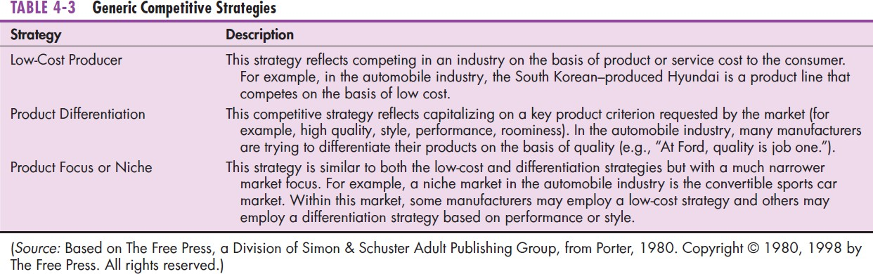
CORPORATE STRATEGIC PLANNING (CONT.)

Slide 25
INFORMATION SYSTEMS PLANNING (ISP)
Information systems planning is a three-step process
An orderly means of assessing the information needs of an organization and defining the systems, databases, and technologies that will best meet those needs
ISP must be done in accordance with the organization’s mission, objectives, and competitive strategy.

Slide 26
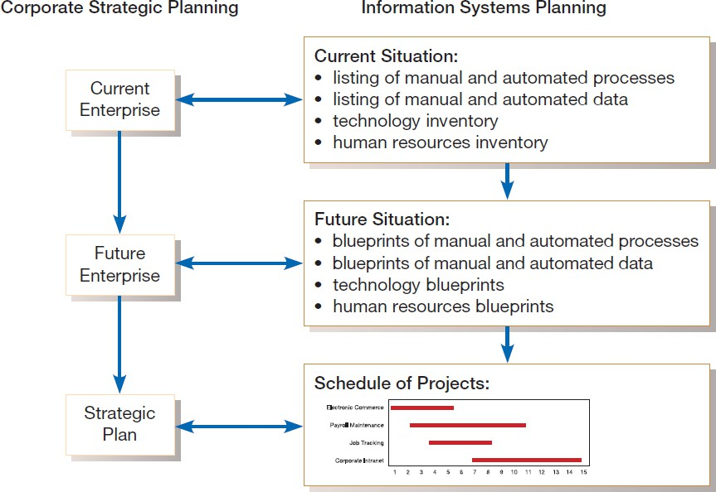
INFORMATION SYSTEMS PLANNING (CONT.)
Parallel activities of corporate strategic planning and information systems planning

Slide 27
INFORMATION SYSTEMS PLANNING (CONT.)
Top-down planning attempts to gain a broad understanding of information system needs of the entire organization and offers:
✴ Broader perspective.
✴ Improved integration.
✴ Improved management support.
✴ Better understanding.

Slide 28
INFORMATION SYSTEMS PLANNING (CONT.)
Bottom-up planning identifies IS development projects based on solving specific operational business problems or taking advantage of specific opportunities.
✴ Can be faster and less costly, so may be beneficial in certain circumstances.

Slide 29
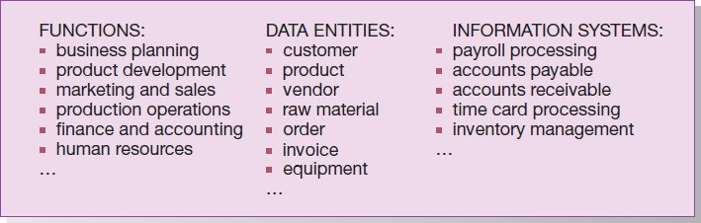
INFORMATION SYSTEMS PLANNING (CONT.)
Information systems planning information (Pine Valley Furniture)

Slide 30
INFORMATION SYSTEMS PLANNING (CONT.)
Functional Decomposition: breaking high-level abstract information into smaller units for more detailed planning

Slide 31
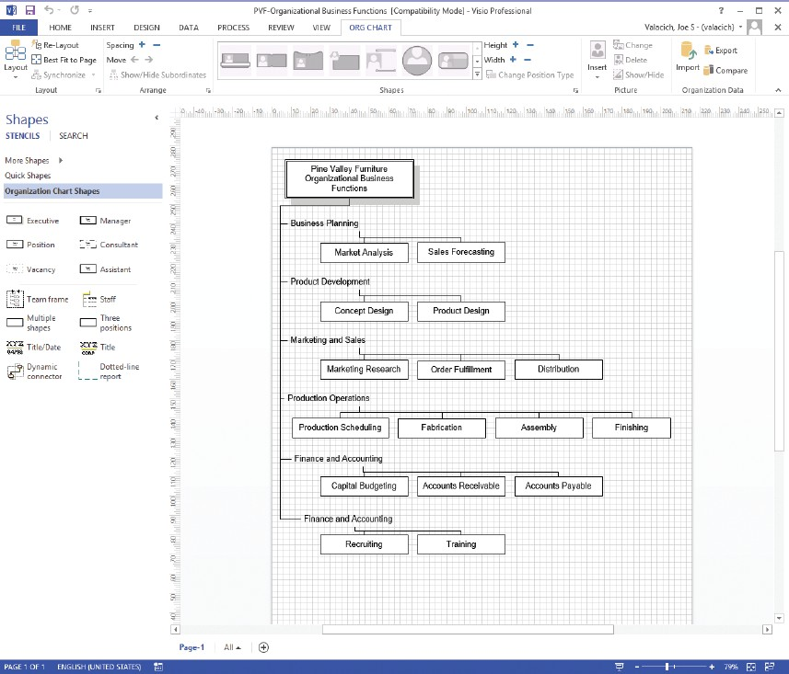
INFORMATION SYSTEMS PLANNING (CONT.)
Functional decomposition of information systems planning information (Pine Valley Furniture)
(Source: Microsoft Corporation.)

Slide 32
INFORMATION SYSTEMS PLANNING (CONT.)
IS planning matrices describe relationships between pairs of organizational elements (location, function, business unit, objective, process, data, information system).

Slide 33
TYPES OF PLANNING MATRICES
Location-to-Function Location-to-Unit Unit-to-Function
Function-to-Objective Function-to-Process
Function-to-Data Entity
Process-to-Data Entity
Process-to-Information System
Data Entity-to-Information System
Information System-to- Objective

Slide 34
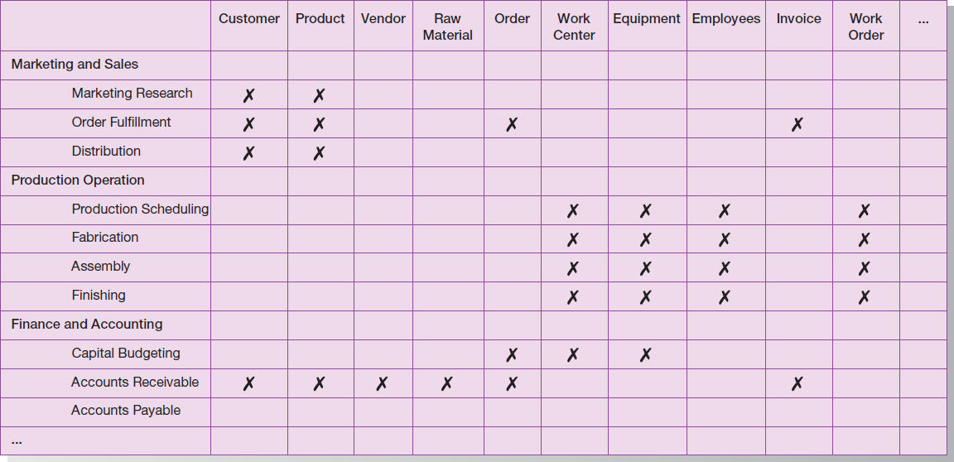
INFORMATION SYSTEMS PLANNING (CONT.)
Data Entity-to-Function matrix (Pine Valley Furniture)

Slide 35
MAKING SENSE OF THE MATRICES
IS planning takes place prior to project identification and selection
“Behind the scenes” analysis
Matrices: as-is (current) and to-be (future, target) CASE tools help via:
Managing information
Matrix construction
Matrix analysis (affinity clustering)

Slide 36
AFFINITY CLUSTERING
Arranging planning matrix information so that clusters of information with a predetermined level or type of affinity are placed next to each other on a matrix report
Affinity – the extent to which information holds things in common Example: Function – to – Data entity matrix
✴ Functions using similar data entities placed in adjacent rows
Data entities used in common by processes in adjacent columns

Slide 37
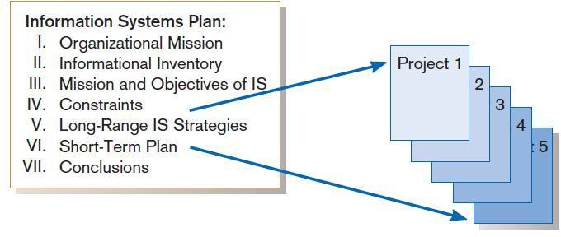
INFORMATION SYSTEMS (IS) PLAN
Systems development projects flow from the information systems plan.

Slide 39
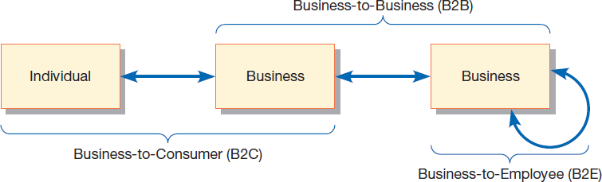
ELECTRONIC COMMERCE:
IDENTIFYING AND SELECTING PROJECTS
Three possible modes of electronic commerce

Slide 40
ELECTRONIC COMMERCE APPLICATIONS AND INTERNET BASICS (CONT.)
Business-to-consumer (B2C): electronic commerce between businesses and consumers
Business-to-business (B2B): electronic commerce between business partners, such as suppliers and intermediaries
Business-to-employee (B2E): electronic commerce between businesses and their employees

Slide 41
ELECTRONIC COMMERCE APPLICATIONS AND INTERNET BASICS
Internet: a large worldwide network of networks that use a common protocol to communicate with each other
Electronic Commerce (EC): Internet-based communication to support day-to-day business activities
Electronic data interchange (EDI): the use of telecommunications technologies to directly transfer business documents between organizations

Slide 42
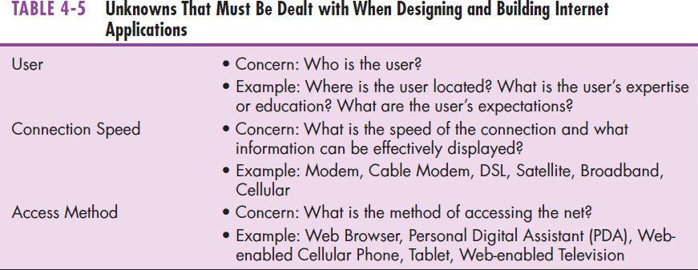
ELECTRONIC COMMERCE APPLICATIONS AND INTERNET BASICS (CONT.)

Slide 43
SUMMARY
In this chapter you learned how to:
Describe the project identification and selection process.
Describe corporate strategic planning and information systems planning process.
Describe the three classes of Internet electronic commerce applications: business-to-consumer, business- to-employee, and business-to-business.

